Slide 1
IBM University Engagement Project Submission
“Exploring the Power of Agentic AI with IBM Granite and LangFlow”

Slide 2
Project Tile – Smart Farming Advice Agent
Domain of Project – Agriculture
Student Name | Recent Passport Photo | Email ID | Mobile number [WhatsApp]
Niyati Buch |  |  | -

Slide 3
Problem Statement - Smart Farming Advice Agent
The Challenge
Farmers often face difficulties in identifying crop diseases, selecting suitable fertilizers, managing irrigation, and obtaining timely agricultural guidance. Access to expert advice is limited, especially in rural areas, resulting in reduced crop productivity and inefficient resource utilization.
The Objective
Develop an AI-powered Smart Farming Advisor that provides farmers with crop management recommendations, pest and disease guidance, irrigation suggestions, and fertilizer recommendations. The system should deliver simple, practical, and timely advice to support informed agricultural decision-making.

Slide 4
Technology Used
LangFlow – Visual workflow design and orchestration platform
IBM WatsonX (Future Integration) – Can be used to deploy and access IBM Granite models.
IBM Granite Models (Future Scope) – Can be integrated to enhance recommendation quality.
Agentic AI – Autonomous decision-making and recommendation generation
Prompt Engineering – Structured agricultural advisory generation

Slide 5
Proposed Solution -
The proposed solution is an AI-powered Smart Farming Advisor developed using LangFlow and designed for integration with IBM Granite models through IBM WatsonX.
The system accepts farming-related queries and provides recommendations regarding crop management, pest control, disease identification, irrigation planning, and fertilizer usage. A prompt-driven agent processes user inputs and generates practical suggestions that farmers can easily understand and implement.
The solution uses a modular workflow consisting of Chat Input, Agent, Prompt Template, and Chat Output components. This architecture enables future integration with external agricultural databases, weather information services, and IBM Granite models for enhanced intelligence and scalability.
The system aims to support farmers in making informed agricultural decisions and improving productivity through AI-assisted guidance.

Slide 6
Langflow component Used -
1. Chat Input – Accepts farming-related questions from users.
2. Agent – Processes user requests and generates agricultural recommendations.
3. Prompt Template – Defines farming-specific instructions and response behavior.
4. Chat Output – Displays generated recommendations.
5. IBM WatsonX Provider – Intended integration point for IBM Granite

Slide 7
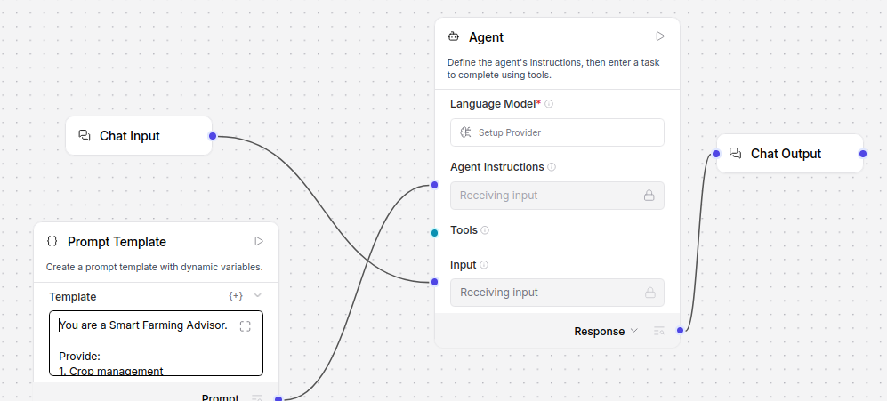
Langflow workflow -

Slide 8
Architecture blueprint
Farmer/User
↓
Chat Input
↓
LangFlow Agent
↓
Prompt Template
↓
IBM Granite Model
↓
Agricultural Recommendation
↓
Chat Output

Slide 9
Role of Agentic AI in the solution
Agentic AI enables the Smart Farming Advisor to function as an intelligent decision-support system rather than a simple chatbot. The agent receives farming-related queries, interprets user requirements, and generates context-aware recommendations.
The system can assist farmers with crop management, pest and disease identification, irrigation planning, and fertilizer recommendations. By using structured prompts and agent-based reasoning, the solution provides practical and easy-to-understand agricultural guidance.
Agentic AI allows the system to automate information processing, improve recommendation quality, and support informed agricultural decision-making. Future integration with IBM Granite models and agricultural knowledge sources can further enhance the intelligence and adaptability of the system.

Slide 10
Technology Used
LangFlow – Visual platform for designing and orchestrating AI workflows.
Agentic AI Concepts – Used to design an intelligent workflow capable of processing farming-related queries and generating recommendations.
Prompt Engineering – Provides domain-specific farming instructions to guide the agent's behavior and responses.
Python Environment – Used to install and run LangFlow locally on Linux.
IBM WatsonX (Future Integration) – Can be used to deploy and access IBM Granite models for advanced agricultural reasoning.
IBM Granite Models (Future Scope) – Large Language Models that can be integrated with the workflow to enhance recommendation quality and decision support.

Slide 11
Token Usage
Prototype Demonstration
• Local LangFlow workflow designed and tested.
• No external API consumption during prototype development.
• Token usage will depend on the selected IBM Granite model during deployment through IBM WatsonX.

Slide 12
Novelty and Uniqueness
• Agriculture-Focused Advisory System – Designed specifically for farming assistance.
• Agent-Based Architecture – Uses an AI agent to process and respond to agricultural queries.
• Modular LangFlow Workflow – Components can be extended with additional tools and knowledge sources.
• IBM Granite Ready – Designed for future integration with IBM Granite models through WatsonX.
• User-Friendly Guidance – Generates practical recommendations understandable by farmers.
• Scalable Design – Can be extended with weather data, soil information, and crop databases.

Slide 13
Git Hub Link
https://github.com/niyatibuch/smart-farming-advisor-langflow

Slide 14
Future Scope
1. Weather Data Integration
The system can integrate real-time weather information to provide more accurate irrigation and crop management recommendations.
2. Crop Disease Detection
Image-based disease identification can be incorporated using computer vision models to assist farmers in diagnosing crop problems.
3. Regional Language Support
Support for multiple regional languages can improve accessibility for farmers across different regions.
4. IBM Granite Integration
Future deployment with IBM Granite models through WatsonX will enhance reasoning capability and recommendation quality.
5. Agricultural Knowledge Base
Integration with agricultural databases and government advisory systems can improve recommendation accuracy.

Slide 15


